Slide 1

Object Detection
Group 2
Jin Lin, Xiaoge Hou, Xinxin Huang, Yifan Zhang

Slide 2
OUTLINES
1
4
Problem Statement
Training & Evaluation
2
5
Models
Demo
3
6
Future Work
Preparation

Slide 3
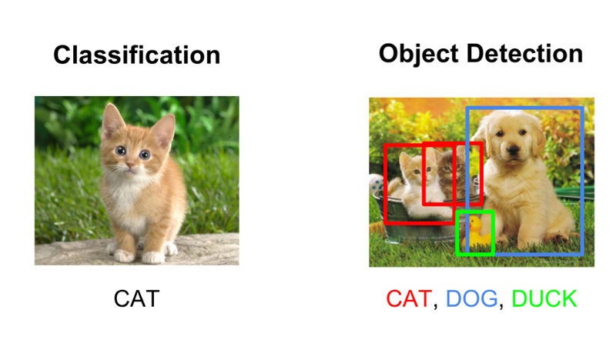
Part.1
Problem Statement
Objectives:
Explore the key concepts in object detection and learn how they are implemented in Faster R-CNN, which are available in the Tensorflow Detection API.
Explore different object detection model: R-CNN, YOLO, Fast R-CNN, Faster R-CNN
Tasks:
Make use of the Python-based TensorFlow object detection API from Google.
Train a model of COCO-pretrained Faster R-CNN with Resnet-101 model on new kitti dataset.
Test model on new images and show performance.

Slide 4
Part.2
Models
01
R-CNN
03
Faster R-CNN & RESNET 101
02
Fast R-CNN
04
YOLO

Slide 5
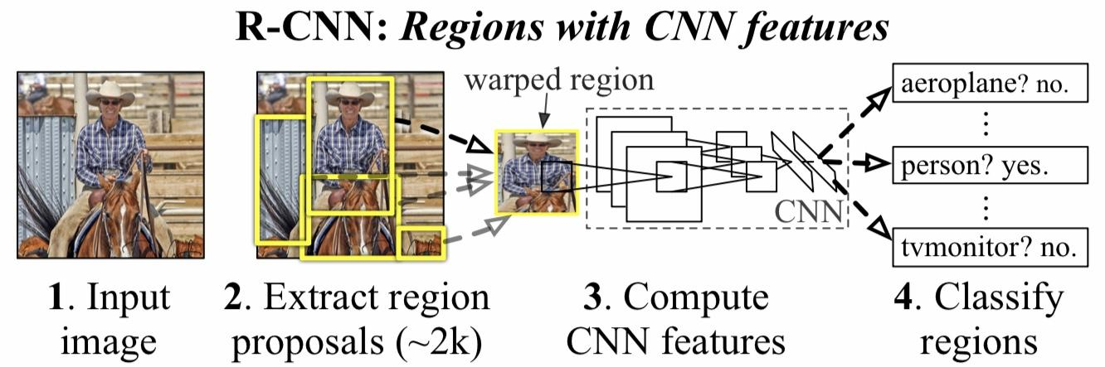
Models - R-CNN
From “Rich feature hierarchies for accurate object detection and semantic segmentation” by Ross Girshick
Generates category-independent region proposals using selective search
CNN extracts feature vectors
Classified by SVM
Notes:
It still takes a huge amount of time to train the network as you would have to classify 2000 region proposals per image.
It cannot be implemented real time as it takes around 47 seconds for each test image.

Slide 6
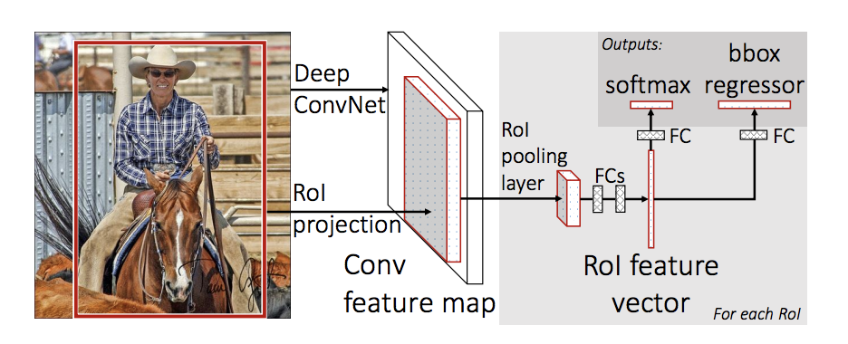
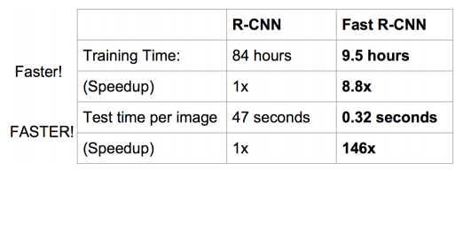
Models - Fast R-CNN
Differents with R-CNN:
Reasons why fast:
Feed the complete input image to the CNN to generate a convolutional feature map;
Identify the region of proposals and reshape them into a fixed size;
Use a softmax layer to predict the class of the proposed region
convolution operation is done only once per image and a feature map is generated from it.
Notes:
From the convolutional feature map, we identify the region of proposals and warp them into squares and by using a RoI pooling layer we reshape them into a fixed size so that it can be fed into a fully connected layer. From the RoI feature vector, we use a softmax layer to predict the class of the proposed region and also the offset values for the bounding box.
The reason “Fast R-CNN” is faster than R-CNN is because you don’t have to feed 2000 region proposals to the convolutional neural network every time. Instead, the convolution operation is done only once per image and a feature map is generated from it.

Slide 7
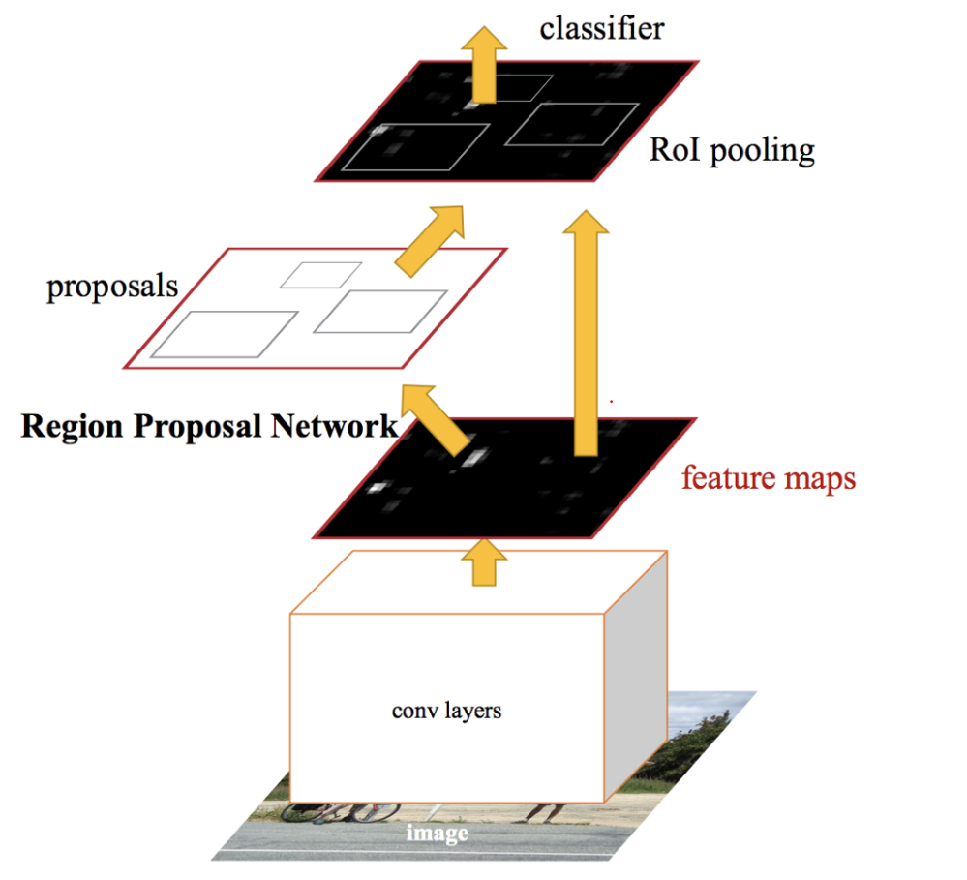
Models - Faster R-CNN
Faster R-CNN: Towards Real-Time Object Detection with Region Proposal Networks
A base network that transforms an image into a feature map.
A region proposal network (RPN) that uses the feature map to predict bounding box candidates.
ROI Pooling splits the input feature map into a fixed number of roughly equal regions, and then apply Max-Pooling on every region to get the same size of regions..
A classifier that uses the feature map and the bounding box candidates to predict the final bounding boxes.
Notes:
Similar to Fast R-CNN, the image is provided as an input to a convolutional network which provides a convolutional feature map. Instead of using selective search algorithm on the feature map to identify the region proposals which is time-consuming, a separate network RPN is used to predict the region proposals.Briefly, RPN ranks region boxes (called anchors) and proposes the ones most likely containing objects.
After RPN, we get proposed regions with different sizes. It’s not easy to make work on features with different sizes. The predicted region proposals are then reshaped using a RoI pooling layer. Then those resized region proposals would be through the classifier to do predictions.

Slide 8
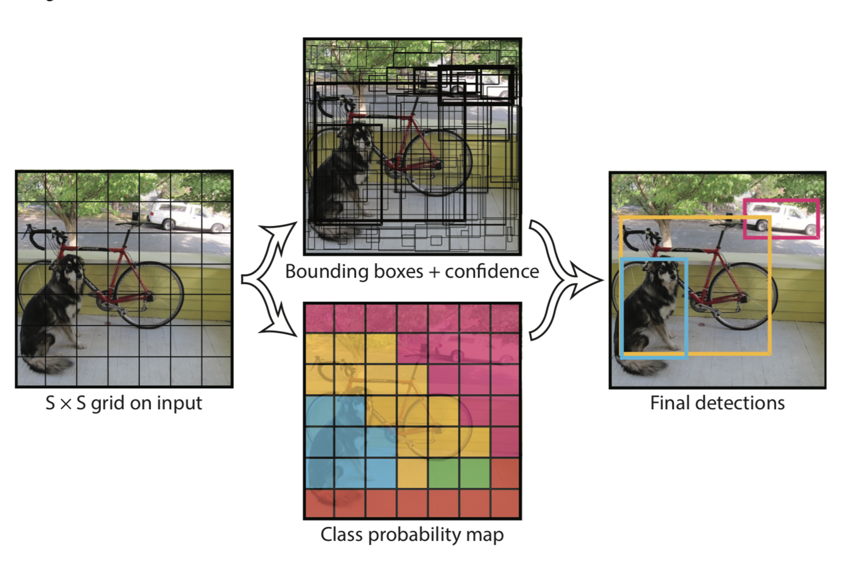
Models - YOLO
Global context.
Single regression problem.
Fast and straightforward.
Limits the number of nearby objects that can be detected.
Makes more localization errors but fewer background errors.
Notes:
Unlike region proposal based techniques, YOLO sees the entire image, trains on full images and makes it much faster.
Because it has strong spatial constraints on bounding box predictions, limits…

Slide 9
Part.3
Preparation
Installation
Compile the protobuf library
Run tensorflow objection API tutorial
Learn the structure of tensorflow API
MSCOCO vs. Kitti dataset
Pretrained model
Notes:
In this part, we are going to talk about the research and work we did before training a model.

Slide 10
Tensorflow API
Required Libraries:
Protobuf 3.0.0
Python-tk
Pillow 1.0
lxml
tf Slim
Jupyter notebook
Matplotlib
Tensorflow (>=1.9.0)
Cython
contextlib2
cocoapi

Slide 11
Tensorflow API
many out-of-the-boxes object detection architectures
SSD (Single Shot Detector)
Faster R-CNN (Faster Region-based Convolutional Neural Network)
R-FCN (Region-based Fully Convolutional Networks)
several feature extractors
MobileNet
Inception
Resnet
several trained models
train in Google Cloud
the support of TensorBoard to monitor the training.
Notes:
The library includes many out-of-the-boxes object detection architectures as well as several feature extractors
these extractors are really significant because they play a huge part in the speed/performance trade-off of the system.

Slide 12
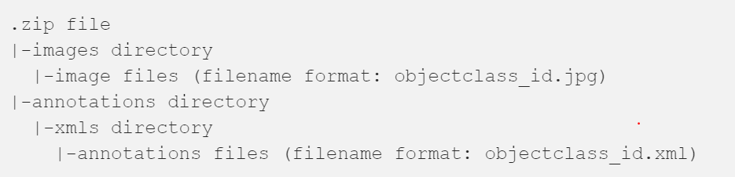
MSCOCO vs. Kitti dataset
Microsoft COCO: a large-scale object detection, segmentation, and captioning dataset; 330K images (>200K labeled) for object detection
Kitti: 7,000 test and 7,000 train images
Notes:
We also take a look into the dataset, and learn what they contain as well as what the structure looks like.

Slide 13
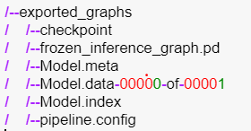
Pretrained Model
faster_rcnn_resnet101_coco_2018_01_28
Decide the pre-trained model to be used. There’s a trade off between detection speed and accuracy, higher the speed lower the accuracy and vice versa.
Notes:
meta file: describes the saved graph structure, includes GraphDef, SaverDef, and so on; then apply tf.train.import_meta_graph('/tmp/model.ckpt.meta'), will restore Saver and Graph.
index file:a immutable table storing variable names. it is a string-string immutable table(tensorflow::table::Table). Each key is a name of a tensor and its value is a serialized BundleEntryProto. Each BundleEntryProto describes the metadata of a tensor: which of the "data" files contains the content of a tensor, the offset into that file, checksum, some auxiliary data, etc.
data file: it is save the values of all variables.

Slide 14
Part.4
Training
01
Preparation
02
Training Process Monitor - TensorBoard
03
Evaluation
Notes:
Building your own custom model

Slide 15
Preparation
1. Dataset Preparation:
Create tfrecord file by “create_kitti_tf_record.py” and “kitti_label_map.pbtxt”. (Additionally we added two more label of “van” and “truck” in label map).
2. Pretrained model Preparation:
Downloaded “faster_rcnn_resnet101_coco_2018_01_28” for transfer training.
Notes:
TFRecords are the “recommended format” for tensorflow, and are roughly equivalent to a list of tf examples. tf examples are roughly equivalent to a more type sensitive list of dicts, where each key (one key per image) in the record is a Feature and each feature has some keys like height that are scalars and some keys like bbox_Xmin that are a list of coordinates with one entry for every bounding box.

Slide 16
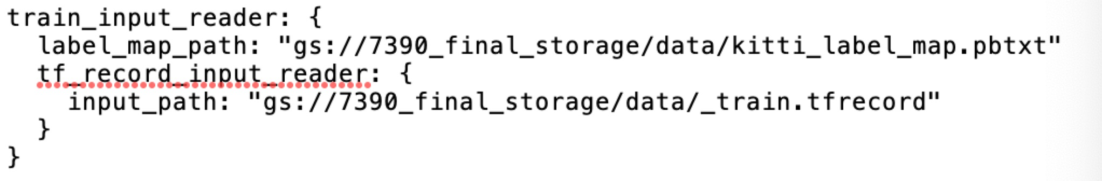
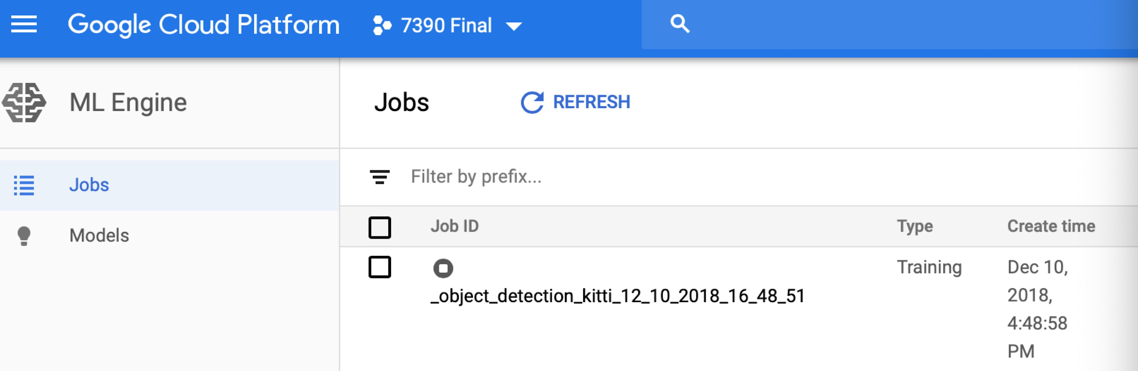
Preparation
3. Edit model config file:
Set the fields of the config file, identified by PATH_TO_BE_CONFIGURED
4. Training model:
Running locally
Running on Google Cloud
Running on Colab
Running on LinuxOS
We have tried four ways to train the new model, at the end we chose to train it on Google Cloud.

Slide 17
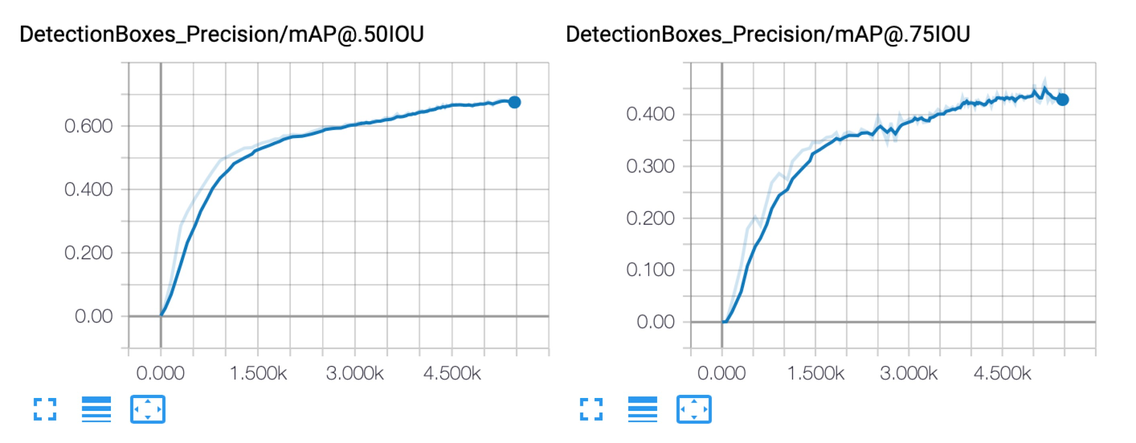
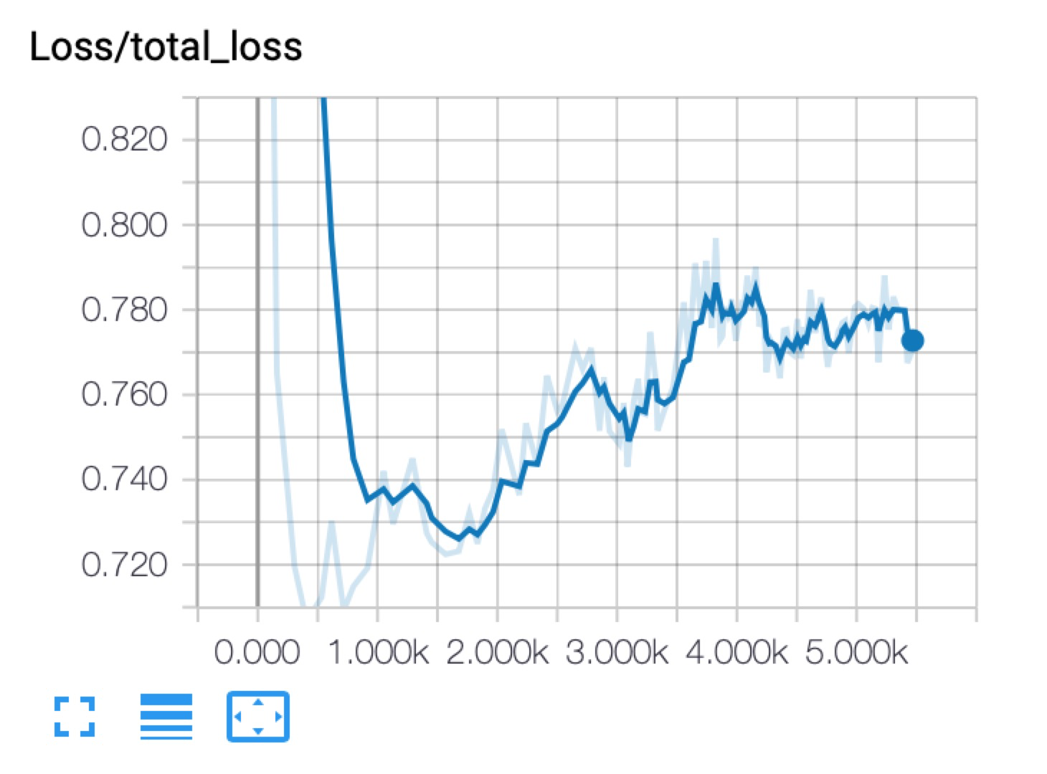
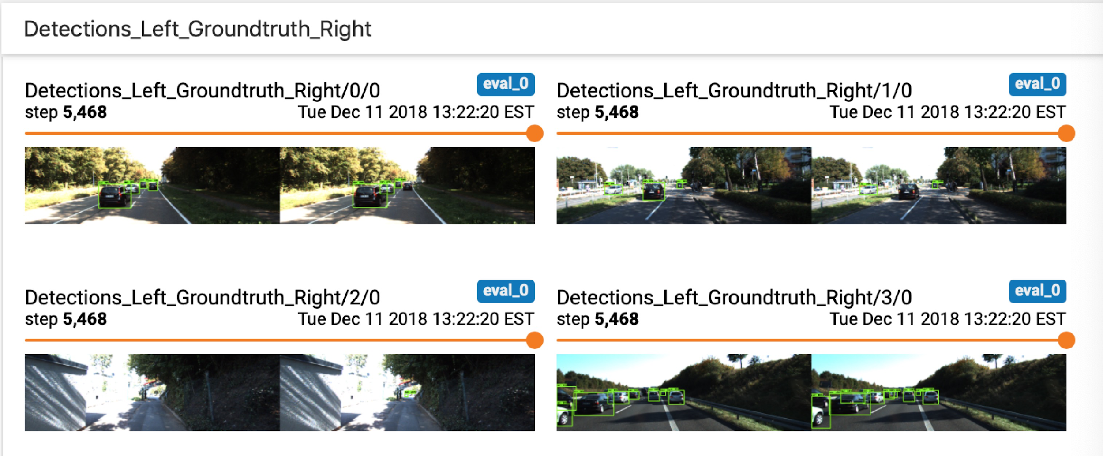
Training Process Monitor - TensorBoard
Precision:
Loss:
Input Images:
Notes:
'DetectionBoxes_Precision/mAP': mean average precision over classes averaged over IOU thresholds ranging from .5 to .95 with .05 increments.
'DetectionBoxes_Precision/mAP@.50IOU': mean average precision at 50% IOU
'DetectionBoxes_Precision/mAP@.75IOU': mean average precision at 75% IOU
'DetectionBoxes_Precision/mAP (small)': mean average precision for small objects (area < 32^2 pixels).
'DetectionBoxes_Precision/mAP (medium)': mean average precision for medium sized objects (32^2 pixels < area < 96^2 pixels).
'DetectionBoxes_Precision/mAP (large)': mean average precision for large objects (96^2 pixels < area < 10000^2 pixels).
'DetectionBoxes_Recall/AR@1': average recall with 1 detection.
'DetectionBoxes_Recall/AR@10': average recall with 10 detections.
'DetectionBoxes_Recall/AR@100': average recall with 100 detections.
'DetectionBoxes_Recall/AR@100 (small)': average recall for small objects with 100.
'DetectionBoxes_Recall/AR@100 (medium)': average recall for medium objects with 100.
'DetectionBoxes_Recall/AR@100 (large)': average recall for large objects with 100 detections.

Slide 18
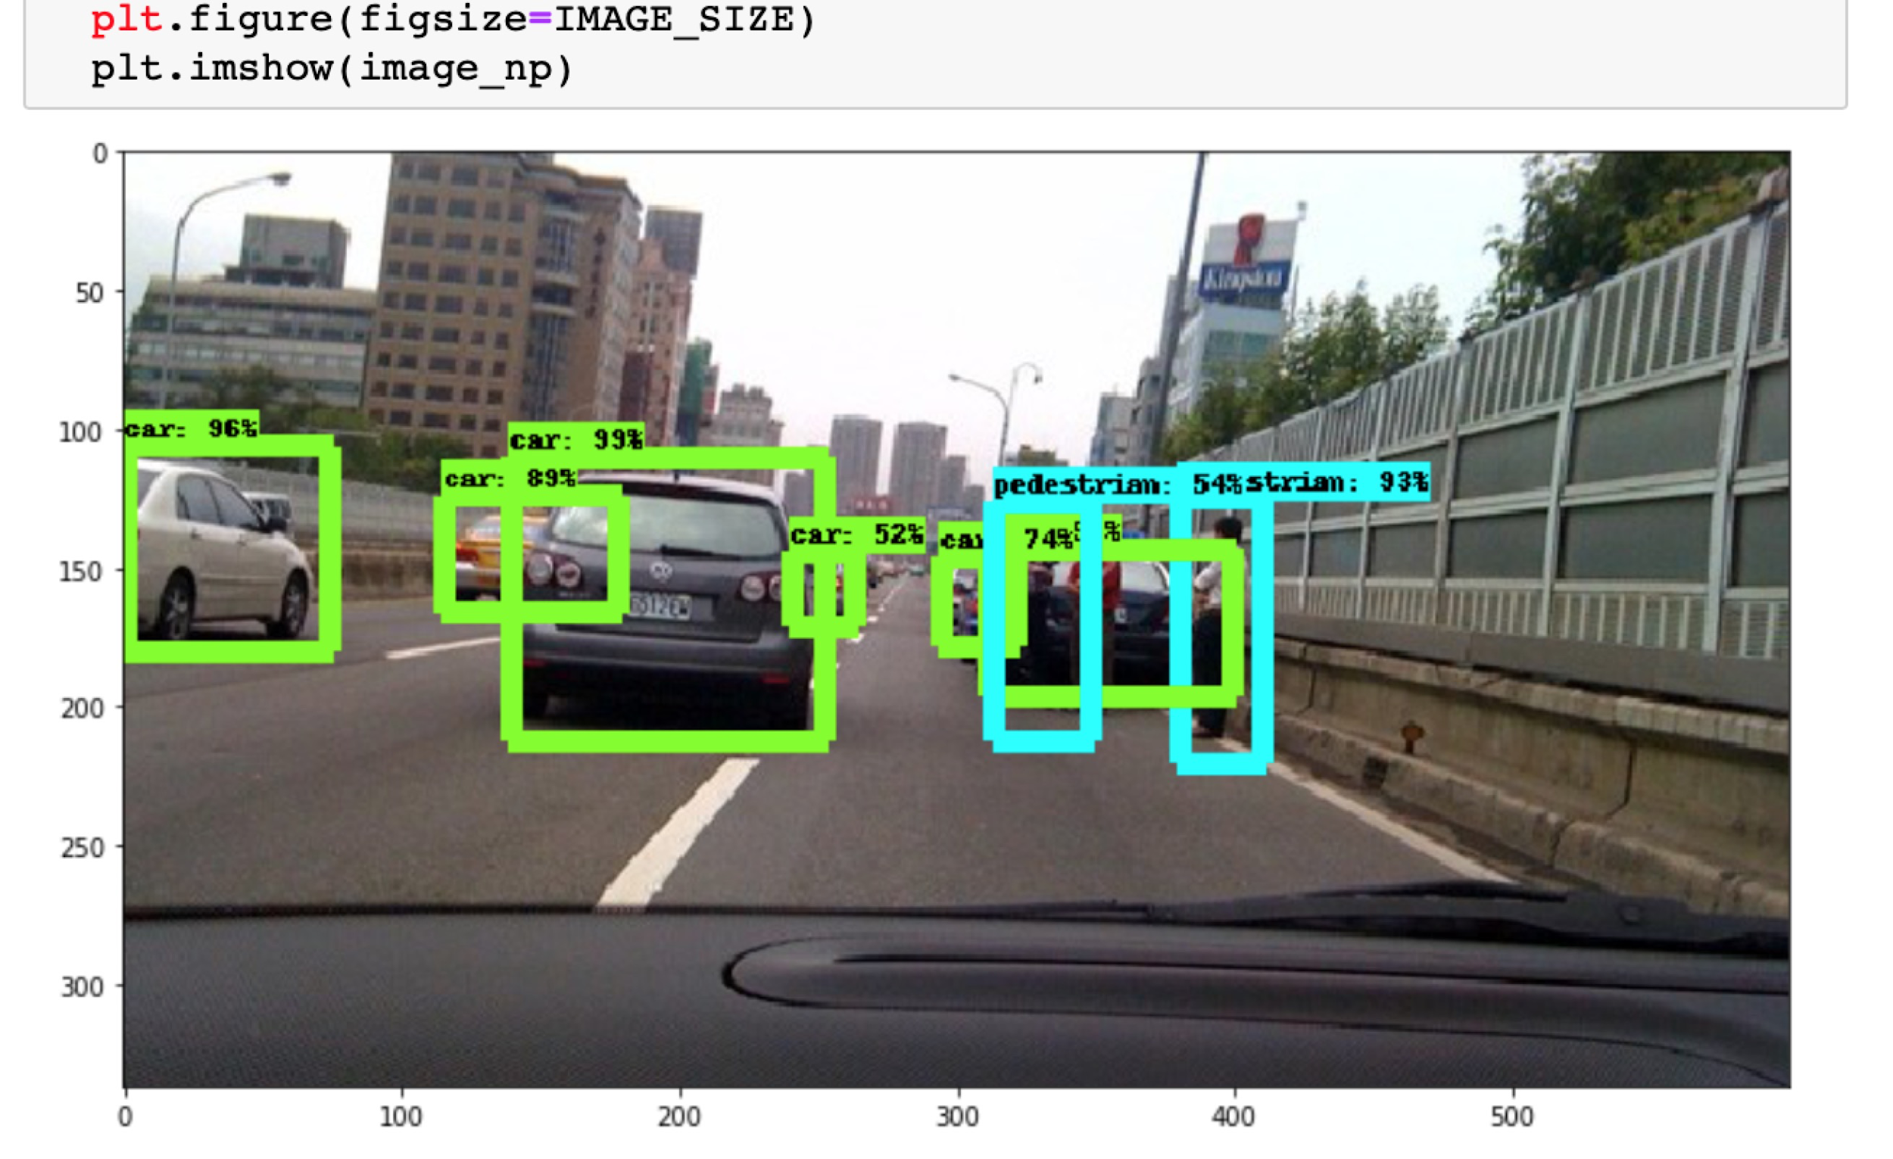
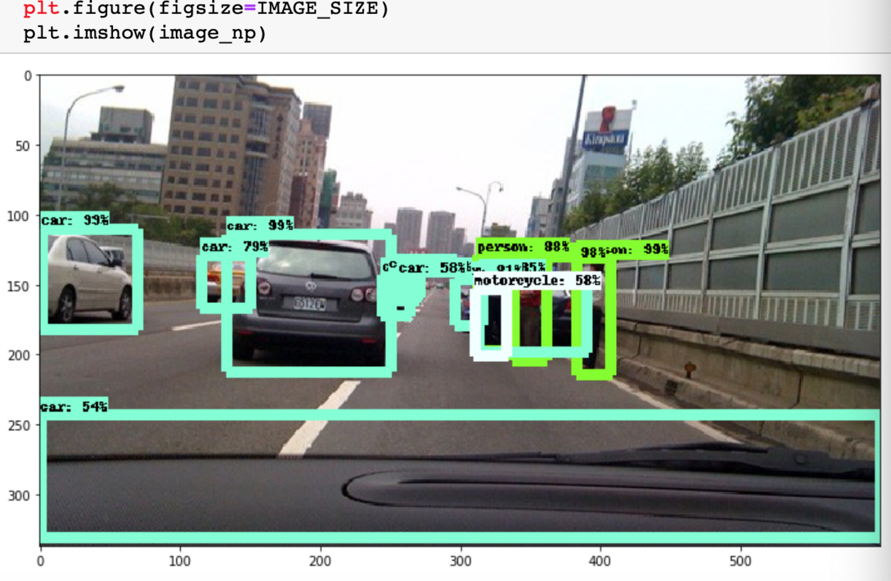
Evaluation
Retrained model:
Pretrained model:
Notes:
The pretrained model can classify more classes, and also, it is able to detect more objects in the two images.
Since the pretrained model has done a good job, our retrained model is difficult to go beyond the pretrained model.
pretrained: 分类比较多，精度差不多，检测的物理比较多

Slide 19
Part.5
Demo
Export trained model: export model to run inference. By calling export_inference_graph.py script in the repo.
Upload image for inference: upload of test image file to run inference.
Run inference: finally it performs inference of the uploaded image, and shows the result.

Slide 20

Apply more models
Explore more on Google API
Retrain with other datasets
Retrain locally
Trade-off between accuracy and speed when deciding the pre-trained model
Fine Tuning
Future Work

Slide 21
Reference
[1] Girshick, R., Donahue, J., Darrell, T., and Malik, J. (2014). “Rich Feature Hierarchies for Accurate Object Detection and Semantic Segmentation,” Proceedings of the IEEE Conference on Computer Vision and Pattern Recognition (CVPR).
[2] Girshick, R. (2015) “Fast R-CNN,” Proceedings of the IEEE International Conference on Computer Vision (ICCV).
[3] Ren, S., He, K., and Girshick, R. (2017). “Faster R-CNN: Towards Real-Time Object Detection with Region Proposal Networks,” IEEE Transactions on Pattern Analysis and Machine Intelligence, Vol. 39, No. 6.
[4] Redmon, J., Divvala, S., Girshick, R., and Farhadi, A. (2016). “You Only Look Once: Unified, Real-Time Object Detection,” https://pjreddie.com/darknet/yolo/.

Slide 22
Thank you !

